Slide 1
CHAPTER 4: Variable manipulation
DAY 2

Slide 2
CHAPTER 4: Variable manipulation
Now let’s recap from yesterday.
  Data step statement names the data set
    Data profit;
  Format statement names variables and tells what kind they are (currency, percent, character)
    Format revenue dollar10.0
    cost dollar10.0;
  Variable statements tells what values go into the variables
    revenue=15;
    cost=10;
  Output statement tells SAS to output the previous variables into a row
    output;
  Run statement tells SAS to finish completing the dataset

Slide 3
CHAPTER 4: Variable manipulation
Looks much more precise in practice
data profit;
format revenue dollar10.0
cost dollar10.0;
Revenue=15;
Cost=10;
output;
run;

Slide 4
CHAPTER 4: Variable manipulation
Common Formats
  $w. Standard character Variable up to ‘w’ spaces long
  w.d Standard number Variable up to ‘w’ spaces long and ‘d’ after the decimal point (notice NO ‘$’ sign
  percentw.d Percent variable up to ‘w’ long and ‘d’ after the decimal point
  dollarw.d Currency variable up to ‘w’ long and ‘d’ after the decimal point
  commaw.d Number variable with commas and decimal points
  datew. writes as dates (date7. => 01JUL11, date9. =>01JUL2011)
Format link http://www.sfu.ca/sasdoc/sashtml/lgref/z1263753.htm

Slide 5
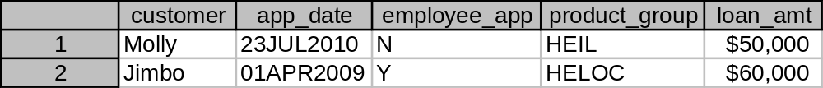
CHAPTER 4: Try on your own 1
Create a dataset named loan_info_1
Create two rows with the following information respectably (format first)
  Customer: Molly, Jimbo
  App_date: 23JUL2010, 01APR2009
  Employee_app: N, Y
  Product_group: HEIL, HELOC
  Loan_amt: 50000, 60000
Hint!: App_date is not Character but it’s also not a regular numeric variable.
  In format statement use ‘date9.’ because 23JUL2010 has 9 digs
  Use “ “ but add a ‘d’ for date➔ “23JUL2010”d
Output ==>

Slide 6
CHAPTER 4: Try on your own 1
(Solution)
data loan_info_1;
format customer $6.
app_date date9.
employee_app $2.
product_group $6.
loan_amt dollar10.;
customer="Molly";
app_date="23JUL2010"d;
employee_app="N";
product_group="HEIL";
loan_amt=50000;
output;
customer="Jimbo";
app_date="01APR2009"d;
employee_app="Y";
product_group="HELOC";
loan_amt=60000;
output;
run;

Slide 7
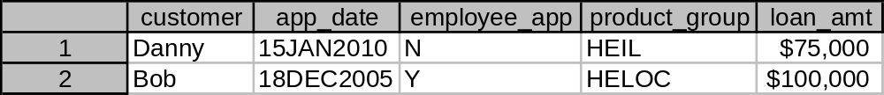
CHAPTER 4: Try on your own 2
Create a dataset named loan_info_2
Create two rows with the following information respectably (remember, format the variables first)
  Customer: Danny, Bob
  App_date: 15JAN2010, 18DEC2005
  Employee_app: N, Y
  Product_group: HEIL, HELOC
  Loan_amt: 75000, 100000
Hint!: App_date is not Character but it’s also not a regular numeric variable.
  In format statement use ‘date9.’ because 15JAN2010 has 9 digs
  Use “ “ but add a ‘d’ for date➔ “15JAN2010”d
Output ==>

Slide 8
CHAPTER 4: Try on your own 2
(Solution)
data loan_info_2;
format customer $6.
app_date date9.
employee_app $2.
product_group $6.
loan_amt dollar10.;
customer=“Danny";
app_date=“15JAN2010"d;
employee_app="N";
product_group="HEIL";
loan_amt=75000;
output;
customer=“Bob";
app_date=“18DEC2005"d;
employee_app="Y";
product_group="HELOC";
loan_amt=100000;
output;
run;

Slide 9
CHAPTER 5: Dataset manipulation
Creating datasets is REAL fun but usually you’re already stuck with the data someone else (possibly you) has created.
Now we’ll put the information from both of the previous data sets (loan_info_1, loan_info_2) together.

Slide 10
CHAPTER 5: Dataset manipulation
data loan_info;
format customer $6.
app_date date9.
employee_app $2.
product_group $6.
loan_amt dollar10.;
customer="Molly";
app_date="23JUL2010"d;
employee_app="N";
product_group="HEIL";
loan_amt=50000;
output;
customer="Jimbo";
app_date="01APR2009"d;
employee_app="Y";
product_group="HELOC";
loan_amt=60000;
output;
customer=“Danny";
app_date=“15JAN2010"d;
employee_app="N";
product_group="HEIL";
loan_amt=75000;
output;
customer=“Bob";
app_date=“18DEC2005"d;
employee_app="Y";
product_group="HELOC";
loan_amt=100000;
output;
run;
We could create one big data set like this:
But it would be a waste since we already have the information in already made datasets.

Slide 11
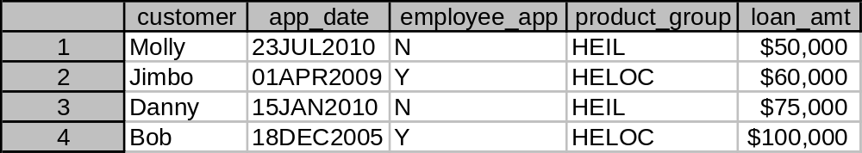
CHAPTER 5: Dataset manipulation
Rather we’ll use the ‘Set’ statement to do it for us.
data loan_info_combine;
set loan_info_1
loan_info_2;
run;
OUTPUT ==>

